Slide 1
Quarterly Macro-Fiscal Outlook
Summary: Forecast 2023-26
March 2023

Slide 2
Background—objectives
Provide forecast for 16 quarters ahead of key macro variables (output, inflation, final demands, ...) as influenced by fiscal, monetary and exchange rate policies, including in response to shocks and new developments
Provide alternative (policy) scenarios around Baseline/judgemental forecast
Complement other projections, like by MINECOFIN Macroeconomic framework, Now/forecasting and by NBR and other institutions
Using forecast tool, Quarterly Macro Fiscal Model, so-called “gap” model:
tracing macro variables in deviation from trends
after shocks and policy responses, variables return to their trends
trends converge to steady states (outside model), e.g. potential output growth, real interest and exchange rates, sustainable deficit, target inflation….

Slide 3
Forecast assumptions
The forecasts are conditional on exogenous and judgemental assumptions:
external environment (foreign prices, demand, food/oil prices, interest rates, ..)
domestic trends distilled from historic data (quarterly 2006-22)
near-term forecasts (now/forecast GDP, latest CPI,…) and known or expected domestic policies (e.g. fiscal stance, next quarter’s interest rate,…)
dis/continuation of recently observed domestic shocks (e.g. in agriculture, food prices and in core-CPI)
Notes:
The QMFM model is originated or derived from a canonical-new Keynesian reduced form model (log-linearized equations of a micro-founded model)

Slide 4
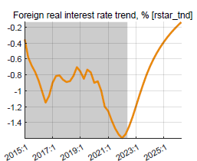
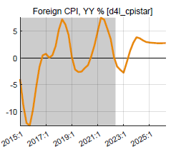
External environment
World economy slowing down as interest rates are raised in response to inflation
Rwanda still enjoys recovery in trading partner demand relative to Covid-years, at 3% p.y., well above trend
World real interest rates are projected to increase from negative in the past decade to positive in near term, and 2-2.5% in MT
Trading partners’ CPI (in US$) was subdued at 1.5% py in past 5-7 years
Projected to return to more normal level of 3% in coming years

Slide 5
Domestic environment
Current fiscal, monetary and exchange rate policies:
Fiscal consolidation with 2022/23 Budget with phasing out of Covid and Ukraine-crisis related spending, and reduction in fiscal deficit and fiscal impulse
Maintenance of current level of policy interest rate (interbank rate)
Somewhat faster exchange rate depreciation in 2023 (than 2022), targeted in PCI
Expected return to normal of agricultural harvests and domestic food prices

Slide 6
Output (real GDP) growth
Output growth: to rise a bit above trend in 2023-24, completing post-Covid recovery
Driven by:
consumption recovering from Covid shocks, helped by below-trend RIR
exports recovering from Covid shocks though hampered by still below-trend RER
government spending to soften Covid- and Ukraine-crises impact ends with FY 2022/23 (see Fiscal Impulse below)
return to trend of 7.5% p.y. from 2025

Slide 7
Output gap: GDP estimated to be below potential (-4% end-2022)
Output gap: GDP is forecast to return to its potential level, i.e. GDP if growth had continued at pre-Covid trend rate.
Driven by:
disappearing Covid down-pull from consumption and exports, which are forecast to return to normal
exports recovering from Covid-related shocks and helped by increasing RER
high government demand and slump in imports in Covid years stop pulling output up

Slide 8
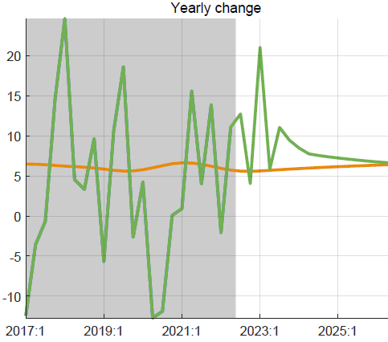
Private consumption growth and gap (similar for investment, exports, imports)
Consumption gap:
key driver of 2020-21 negative output gap (+ 75% of GDP)
Covid negative shocks (persistence) forecast to end in 2023
fiscal impulse helped offset somewhat negative Covid consumption shocks but it is ending in 2023
Consumption growth:
continued recovery from Covid, with higher than trend growth in 2023-24
returns to its trend growth from 2025

Slide 9
Government demand for G&S and fiscal impulse
Fiscal impulse:
discretionary deficit plus change in structural deficit (% GDP); mainly reflects discretionary spending (demand for G&S and transfers etc.)
affects output directly (via demand for G&S) and indirectly via private consumption and investment; combined……during
Covid years: 2¼% of GDP fiscal impulse→ 2% of GDP output effect
Government demand for G&S (+ 23% of GDP):
mainly exogenous (discretionary spending)
higher government demand under Covid directly offset negative output gap
offsetting effect ends as crisis-related spending ends in 2023
Notes:
See Output gap and Fiscal Impulse in last Chart

Slide 10
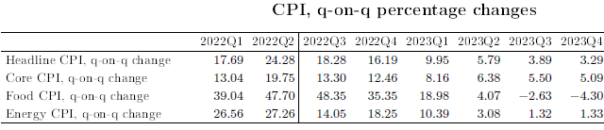
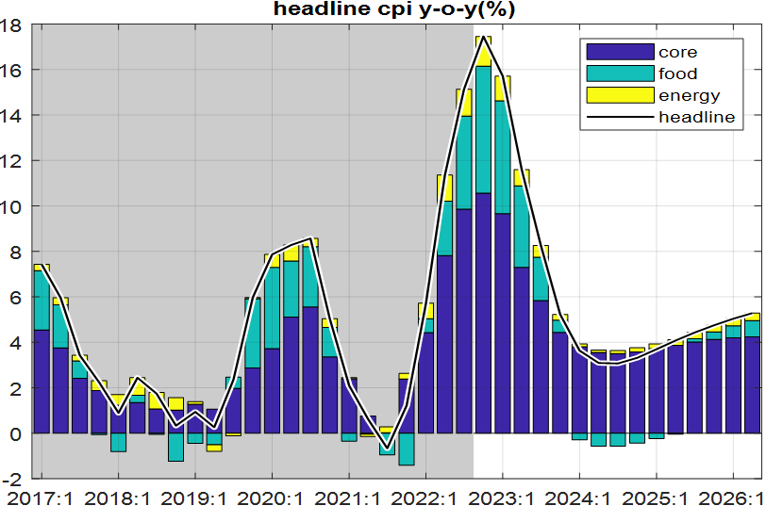
Inflation outlook (overview)
q-on-q annualized inflation is forecast to decline gradually in 2023 after peak in Q2 2022
predicated on recent shocks abating and inflation expectations being countered by NBR action and fiscal restraint
Headline CPI components
decline in q-on-q inflation translates into a lesser drop in y-on-y inflation estimated to peak in Q4 2022,
Y-on-y inflation dropping to below 5% in early 2024
all components drop, drop in food prices contributes most

Slide 11
Food inflation (q-on-q annualized)
Direct effect of foreign prices and ER on food CPI
foreign food prices continue declining for most of 2023-26
ER depreciation raises RWF prices but net direct effect is small
CPI food decreasing from peak in 2022 Q3; main drivers:
agricultural output is forecast to normalize
imported food prices projected to continue declining
small offsetting effect of lessening RER overvaluation (faster depr.)

Slide 12
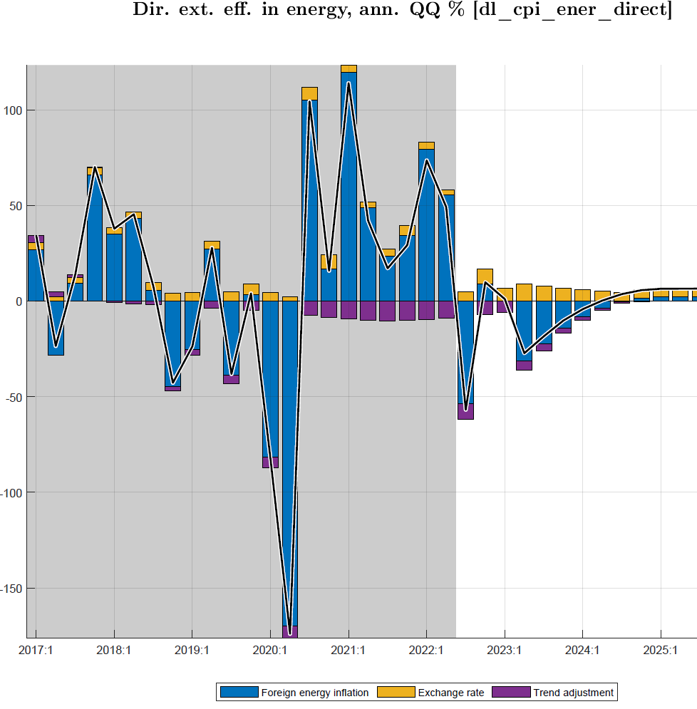
Energy inflation (q-on-q annualized)
Direct effect foreign import prices and ER on energy CPI:
foreign energy prices continue declining for most of 2023-26
ER depreciation raises RWF prices, but net direct effect is small
CPI energy decreasing from peak in 2022 Q2; main drivers:
imported energy prices projected to continue declining
small offsetting effect of lessening RER overvaluation (faster depr.)

Slide 13
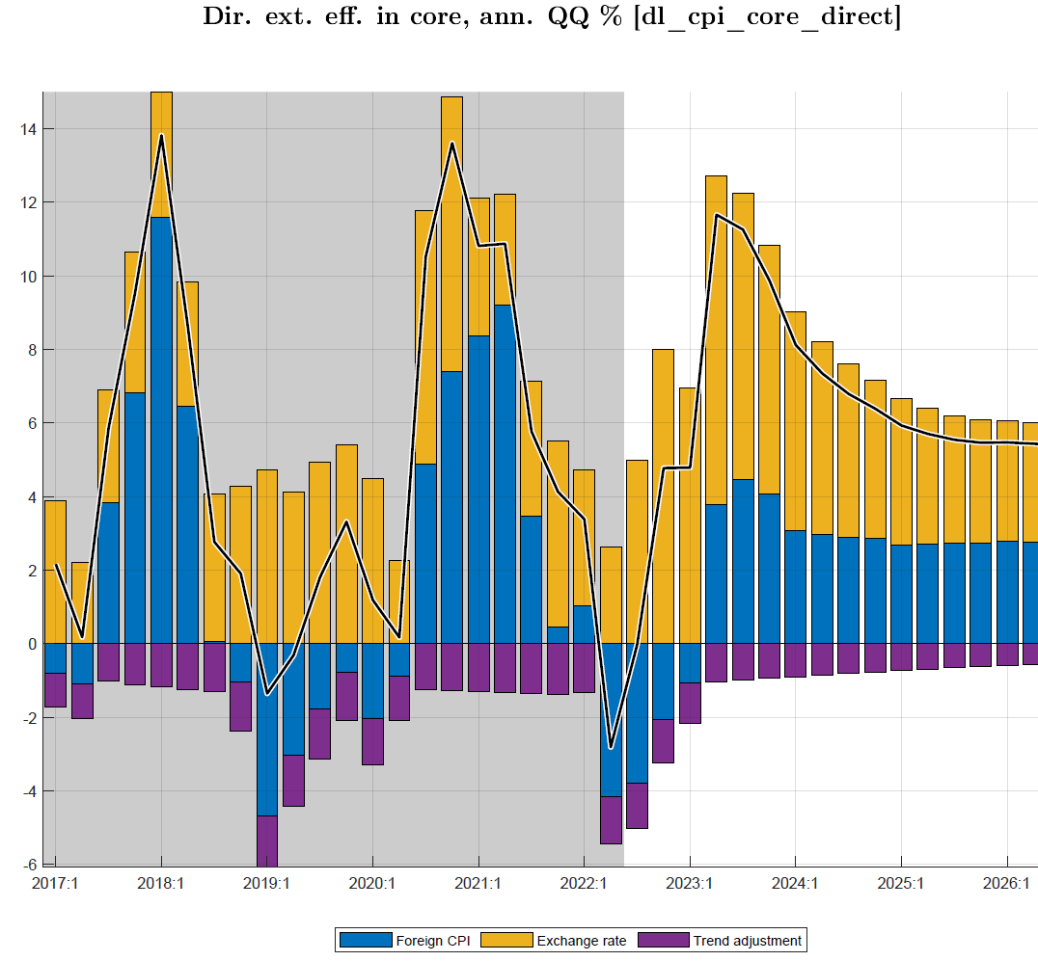
Core inflation (q-on-q annualized)
Direct effect foreign import prices and ER on CPI core:
foreign prices continue declining for most of 2023-26
ER depreciation raises RWF prices, but net direct effect is small
CPI core from peak 2022 Q2; main drivers:
down-pull effect from remaining output gap disappearing
strong effect of expectations and persistence
no direct effect of import prices as constant in RWF terms

Slide 14
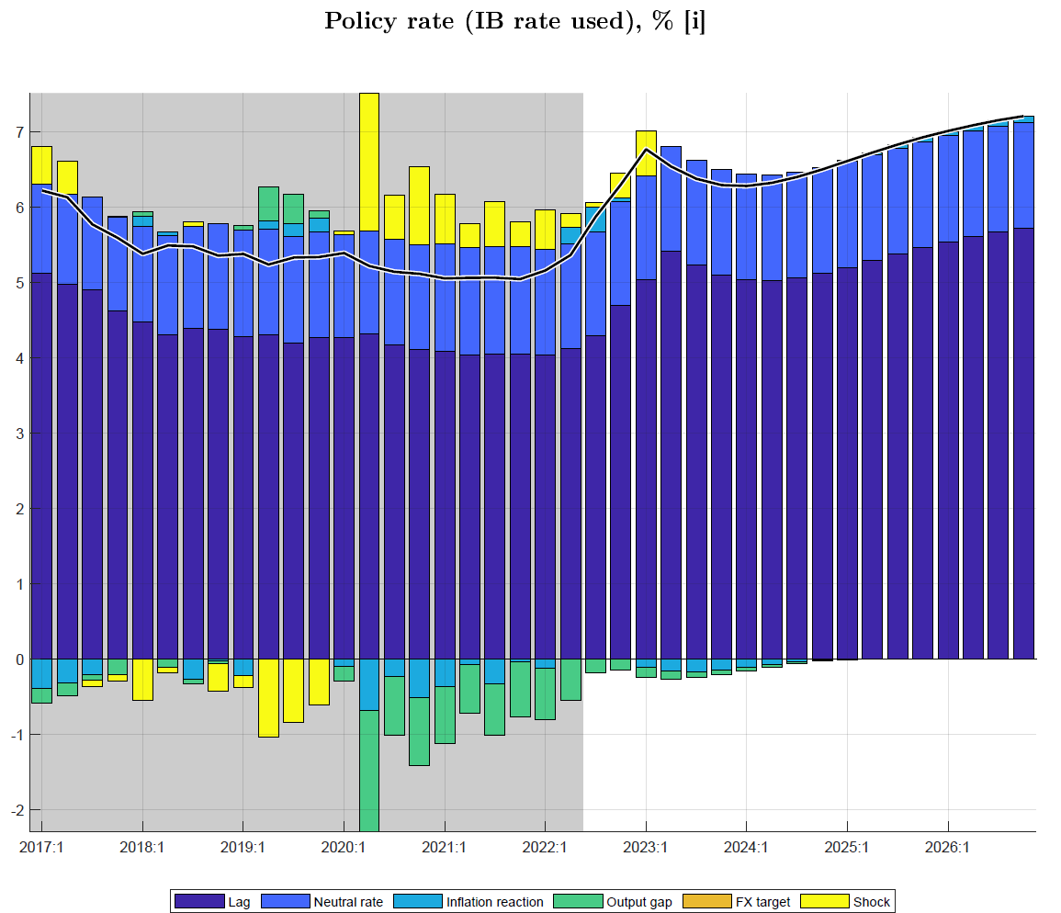
Policy interest rate (interbank rate, IB)
Policy rate (IB) is driven by Taylor rule:
responding to both inflation deviation (from 5% target) and output gap
gradual interest rate changes (lagged effect)
pulled to ‘neutral’ rate of +7% (foreign real rate, country risk, core inflation)
Policy rate (IB) influenced by NBR with its CBR:
IB followed closely the 2% points CBR increases in 2022
IB forecast to increase in 2023 Q1 to combat inflation,
then to decrease to pull output to potential level (still gap)
from 2024, increase to trend driven by ‘neutral’ rate of +7%
increased policy rate should raise RIR and stem demand

Slide 15
Real interest rate (RIR) (policy and lending rates)
RIR policy rate (IB) components:
after sharp drop in RIR (IB) due to inflation surge in 2022, RIR starts rising from mid-2022 as policy rate increases and inflation declines
RIR policy rate (IB) (~ core-inflation one Q ahead)
forecast to continue rising and turn positive by mid-2023
thus, correcting sharply below-trend levels since late 2021
from 2024, return toward trend and ‘neutral’ rate of 2.5%
real lending rate (including +8% premium) also back to trend. ending the pull-up effect on private demand

Slide 16
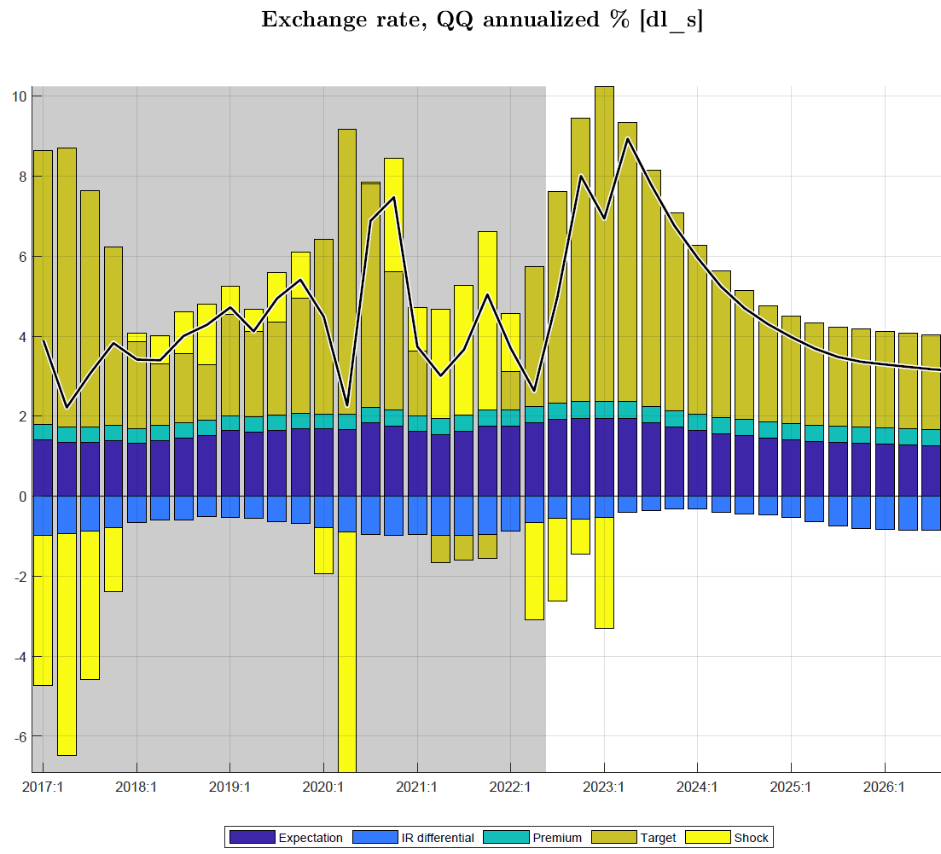
Nominal exchange rate (ER)
Exchange rate policy “rule”
mainly driven by ER target, expectations, and somewhat by domestic-foreign interest rate differentials
ER target driven by trend RER depr. rate (0%) and inflation differential (2%)
ER policy reflected in forecast:
reflects NBR’s flexible ER policy, hybrid rule:
ER steered toward target ER so that RER gradually falls in line with its target or trend depreciation rate
some response to domestic-foreign interest differentials
in 2023, ER forecast to move faster to target
trend depreciation rate converges to +2% p.y.

Slide 17
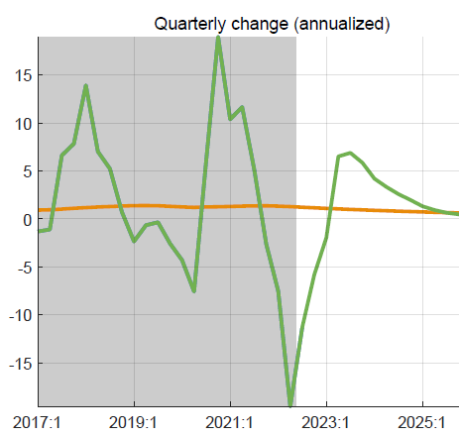
Real exchange rate (RER, q-on-q change annualized)
RER components
after sharp decline in RER since Q3 2021 as core inflation surged,
RER is forecast to increase from Q2 2023 on for several quarters
before returning to its trend (0%)
RER results from ER, CPI_core and foreign CPI
forecast to switch from real appreciation in 2022 and early 2023 to real depreciation from mid-2023
returning toward trend RER depreciation rate (0%) thereafter
pull-down effect on demand from RER appreciation in most of 2022 should reverse from 2023 onward as RER returns to trend

Slide 18
Overall Policy stance and Forecast outlook
Policy stance underlying the forecast
maintenance of recently increased policy interest rate (tuned for 2023Q1)
somewhat faster rate of exchange rate depreciation in 2023 (tuned for 2023Q1)
reduction fiscal deficit (before grants) to 12.1% of GDP in 2022/23 (tuned), then to 11% of GDP (sustainable)
favorable fiscal impulse—over 2% of GDP on average in 2020-2022—is ending
Forecast of key macro indicators
RIR forecast to rise (albeit from a low negative level) and exert less upward pressure on private demand
RER forecasted to rise from low, negative level and exert less downward pressure on private demand
Headline inflation (estimated peak in Q4 2022) forecast to decline gradually in 2023 as food and energy prices forecast to continue falling from their peaks in 2d half of 2022; and to be close to 5% target from 2024
GDP growth forecast to pick up to average 8.5% in 2023-24 before returning to its trend of 7.5% annually
Output back to potential as low (albeit rising) RIR, rising (of albeit still low) RER, and modest (albeit declining) fiscal impulse keep demand up
Recommendations/take aways pm
Notes:
Both RIR and RER return gradually to their steady states of RIR of 2.5% and RER depreciation rate of 0%

Slide 19
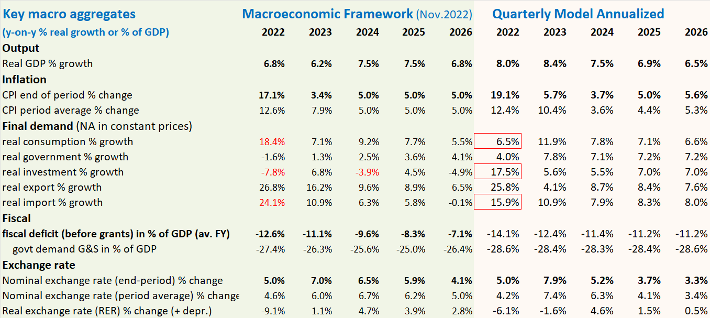
Comparison with Macro Framework

Slide 20
Comparison with Macro Framework (MF)
Illustrative comparison with Nov. 2022 projection (PCI)
compared to MF, the annualized QMFM result has:
lower volatility in final demand components, especially for consumption, investment and imports (MF needs consumption-savings checks)
higher average CPI inflation in 2023, more accurate as QMFM traces inflation by quarter
lower ER depreciation from 2024, as it forecast zero RER depreciation in medium term
(MF has real depreciations each year in 2024-26)
higher fiscal deficits, return to sustainable level, while PCI reduces deficit much below that
correctly reproduced historic data

Slide 21
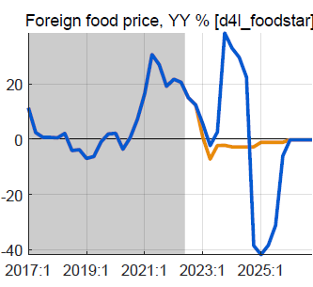
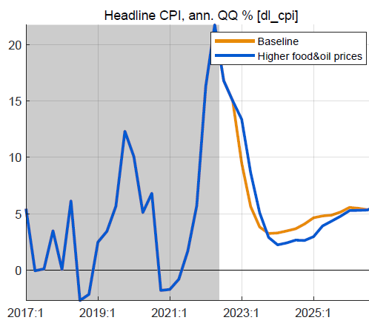
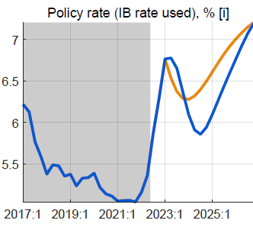
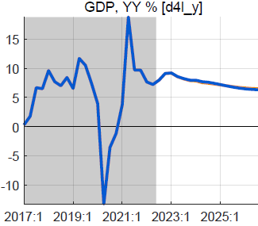
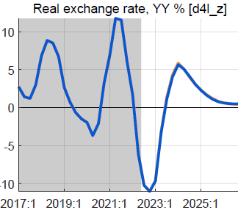
Alternative scenario: higher foreign food/oil prices (2023-24)
Higher-than-WEO foreign food and oil prices in 2023-24
foreign food and oil prices on average 25% higher than BL
with peak around end-2023, return to WEO levels from 2025
no change in fiscal policy
Results in higher headline CPI, little or no effect on output
headline CPI temporarily higher, reflecting food/oil import shares
small response policy rate, reversed fast as expected inflation drops
small positive effect on demand of lower RIR
but mostly offset by negative effect of slightly more appreciated RER

Slide 22
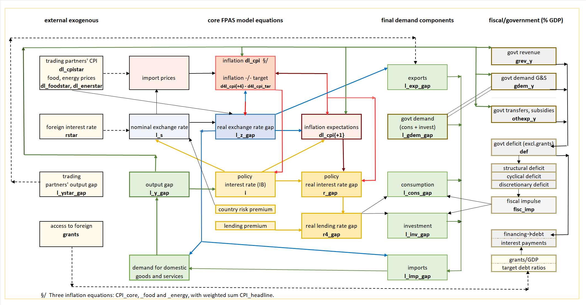
QMFM: main relationships and transmission mechanisms

Slide 23
Notes:
Optional illustration of fiscal impulse in relation to output/gap

